Slide 1

BRAIN CODER
AMONG US HACK PROJECT
THILLAI CHITHAMBARAM
KAVITA NAMPOOTHIRI SNEHA GOPALAKRISHNAN

Slide 2
WHAT IS BRAIN CODER
Brain Coder is a website to keep track of the students’ progress.
It offers the link to various courses and tests which can help in improving the knowledge about different domains

Slide 3
WHY BRAIN CODER?
Everyone struggles with keeping track of whether the students are actually learning new concepts.
This website can make that process so much easier.
It has various levels of difficulty and the students are free to choose from the multiple domains offered.

Slide 4
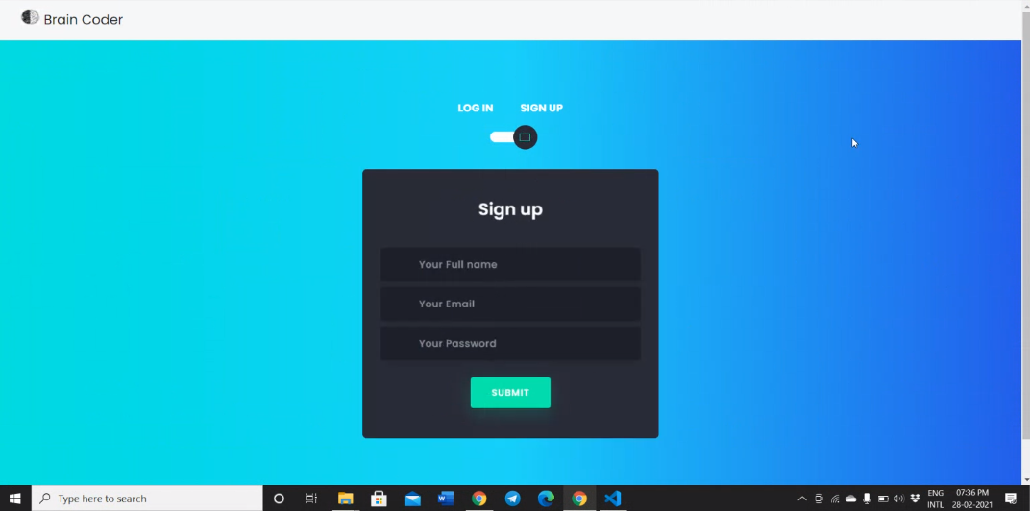
SIGN IN/SIGN UP
The students will first be required to sign up

Slide 5
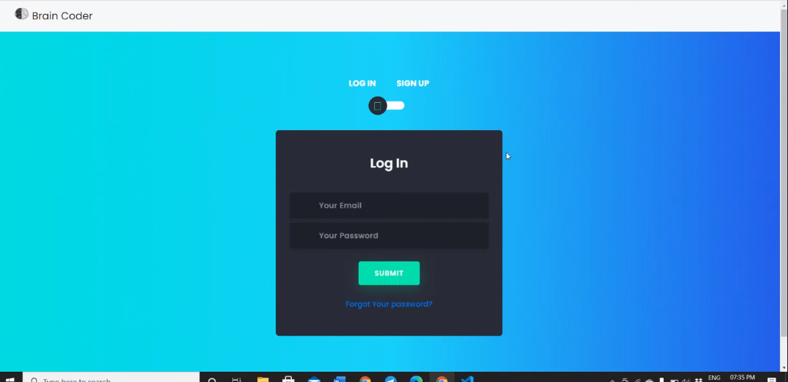
The students can then sign in to continue using the website

Slide 6
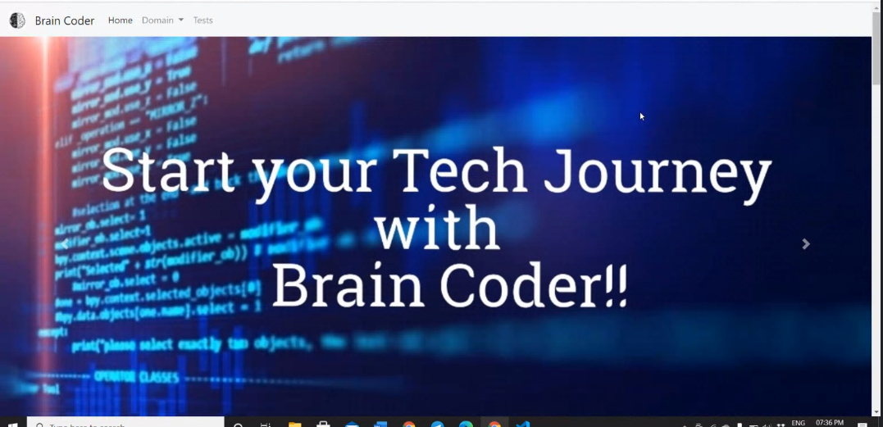
The different domains can be accessed from here
The tests for the different domains can be accessed from here

Slide 7
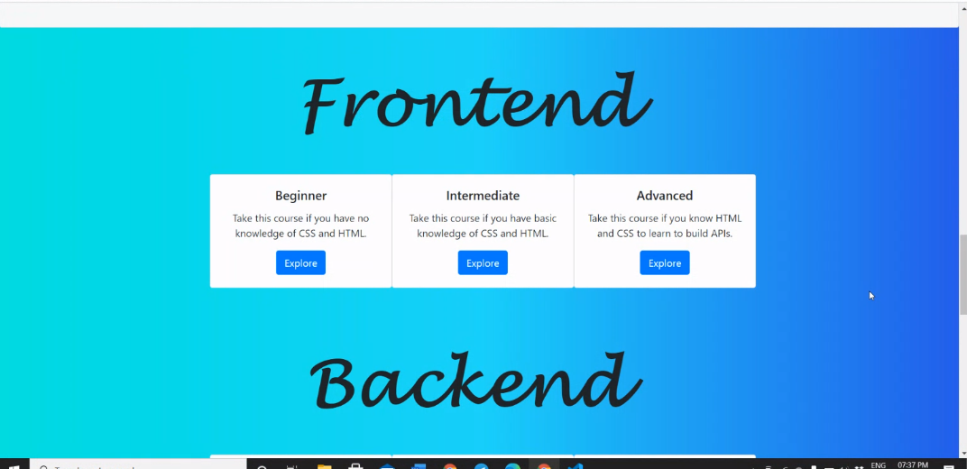
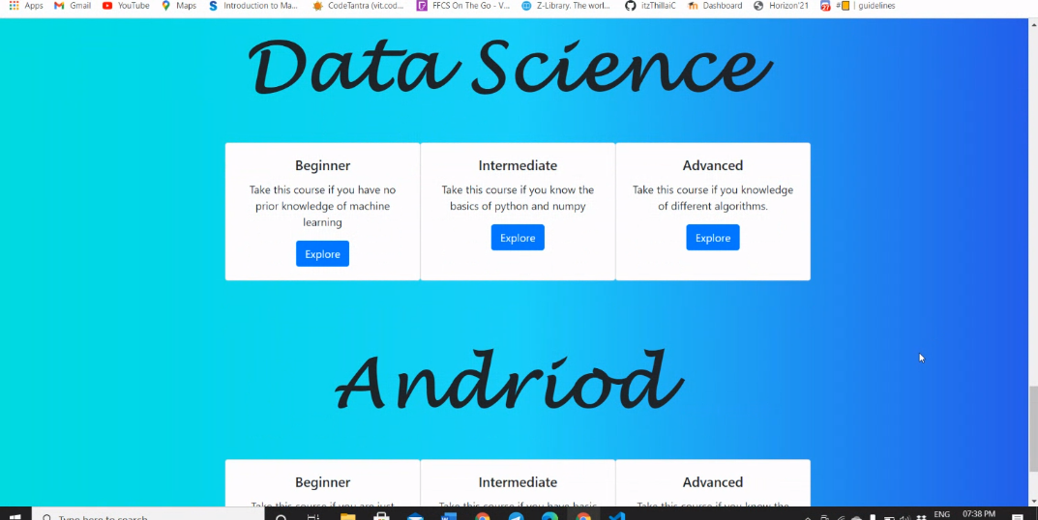
If you are confused about which level you are at, read the description to get a clear idea!
By clicking on explore, you can get access to the various links according to the level you choose.

Slide 8
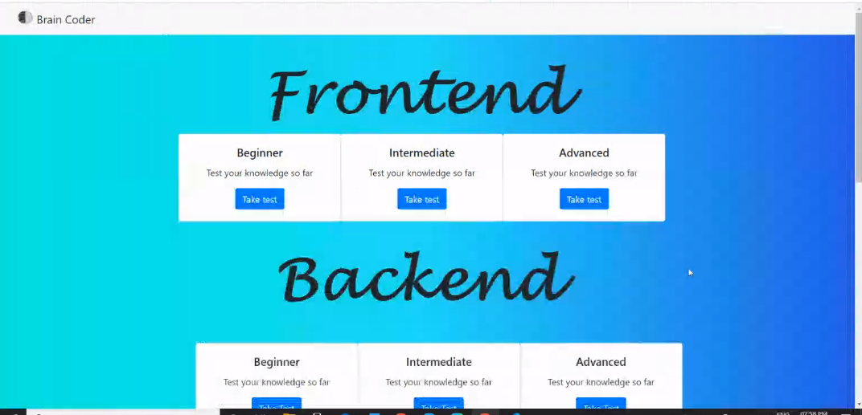
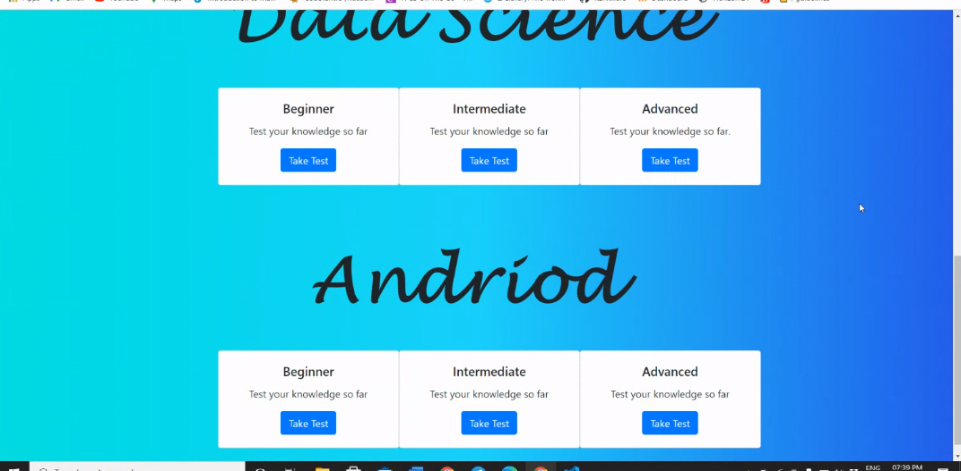
When you’ve finished the courses, you can take these tests to test your knowledge
If you’re not satisfied with your test results, you can always go back and practice more!

Slide 9
CONCLUSION
In today’s world where everything is online, our website will be the right place for you to start your tech journey and learn new things in an efficient way

